Slide 1


How to make Pokemon Go Safe!
A case study

Slide 2
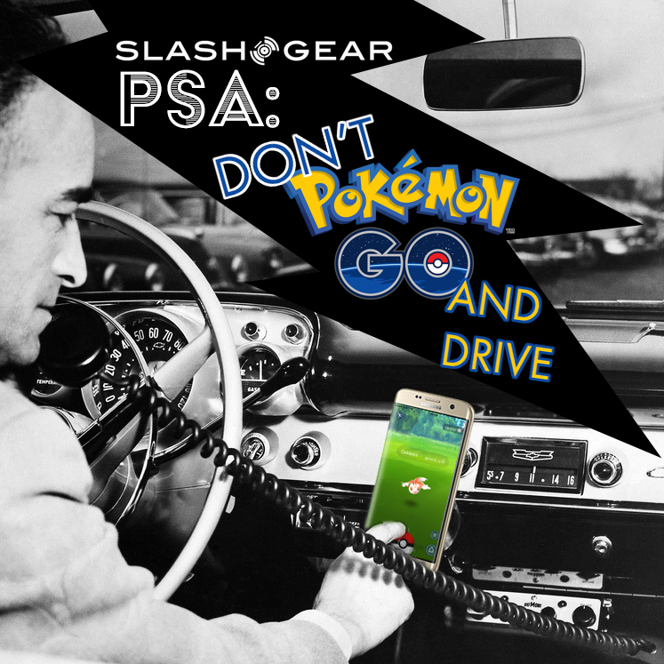
Why to make it safe?
A pair of men were injured while playing Pokemon GO when they fell off a cliff overlooking the Pacific Ocean. Apparently the men broke through a fence to catch a Pokemon, despite posted signs warning people that the bluffs they were climbing onto were unstable.
Then we have the case of an ex-Marine crashing his younger brother's car into a tree because he was playing Pokemon GO while driving.

Slide 3
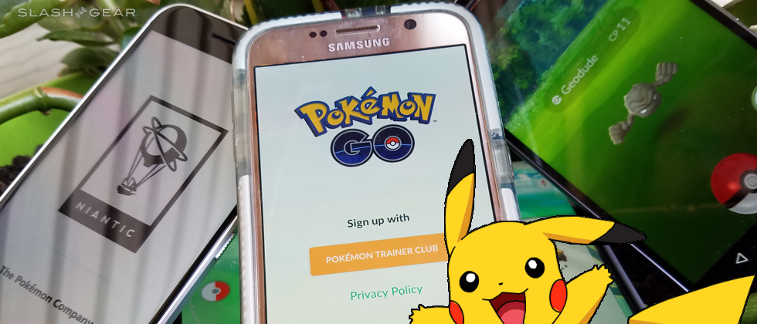
Two Quebec City police officers suffered minor injures when a Pokemon GO player backed his car into their police cruiser. The police officers said they were observing the car, which was driving strangely though a parking lot, when the driver suddenly backed into their cruiser. The driver was playing Pokemon GO, apparently hunting for monsters in the lot.
These incidents are not going to stop no soon, its up to us use it carefully.

Slide 4
What can be done to make it safe?
A pop up notification may be sent to the users alerting them about the surroundings.
Put some more loading screens after the capture of pokemon so that the users will have a look around the surrondings.
When the player is moving which is sensed is pokemon go, a initial option need to be given to the user to first look at the surroundings and then continue.
Raise a caution message when the player reaches a dangerous location.
The last option is to create awareness to people and this will be better than the other solutions.

Slide 5
Thank You
The Triads

